Slide 1
Game Modes

Slide 2
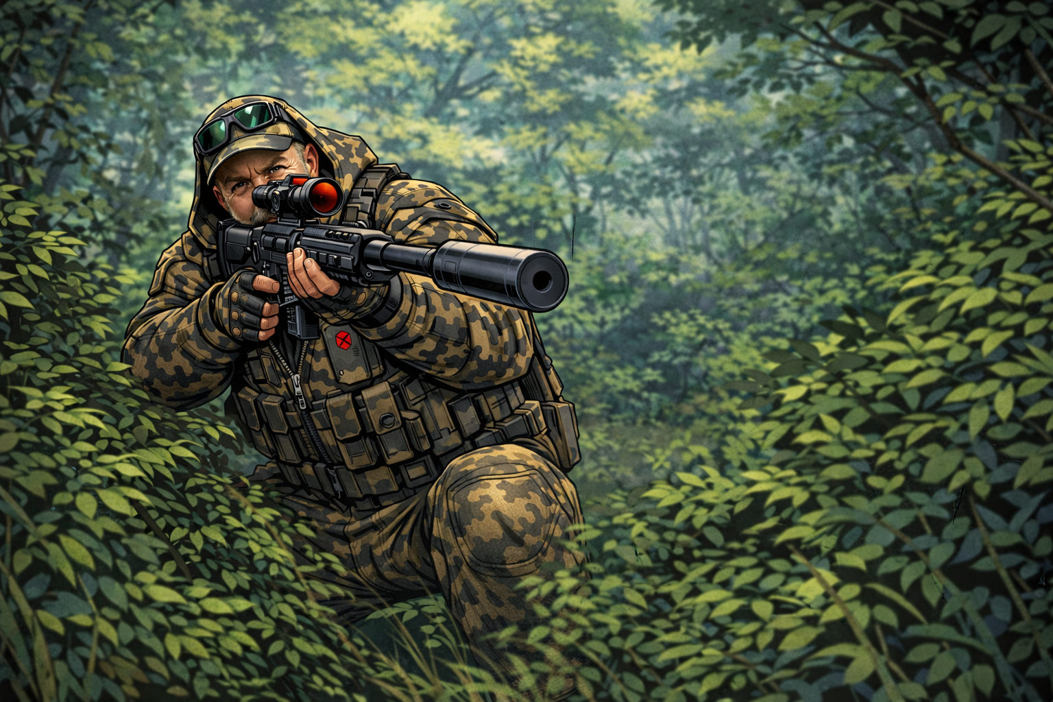
Dan Rhon Deathmatch
Team: 6 vs. 6
Objective:
Be the team with the most kills when time runs out. Winner receives the glory and the coveted love of Dan Rhon

Slide 3
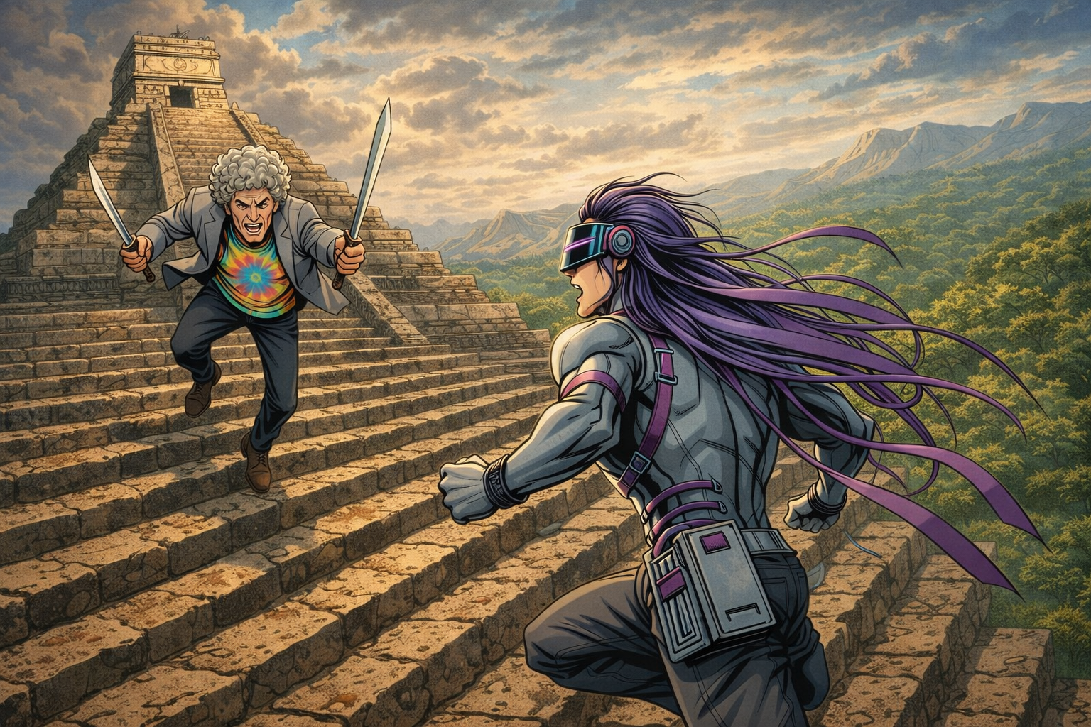
Charge on Chexico
Team: 6 vs. 6
Objective:
Offense - Rush to the top of the Chexico temple and construct the statue of Colin Amazing
Defense - Stop the attacking team from building their statue until time runs out.

Slide 4
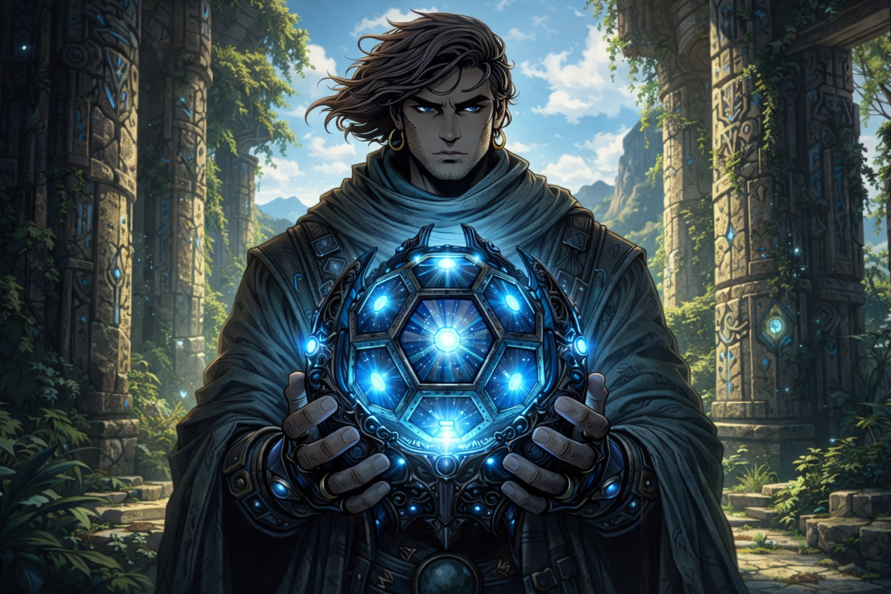
Tessarune Turf War
Team: 6 vs. 6
Objective:
Take control of both the Tessarune and Ressatune by stealing one from the other team and bringing it to your turf

Slide 5
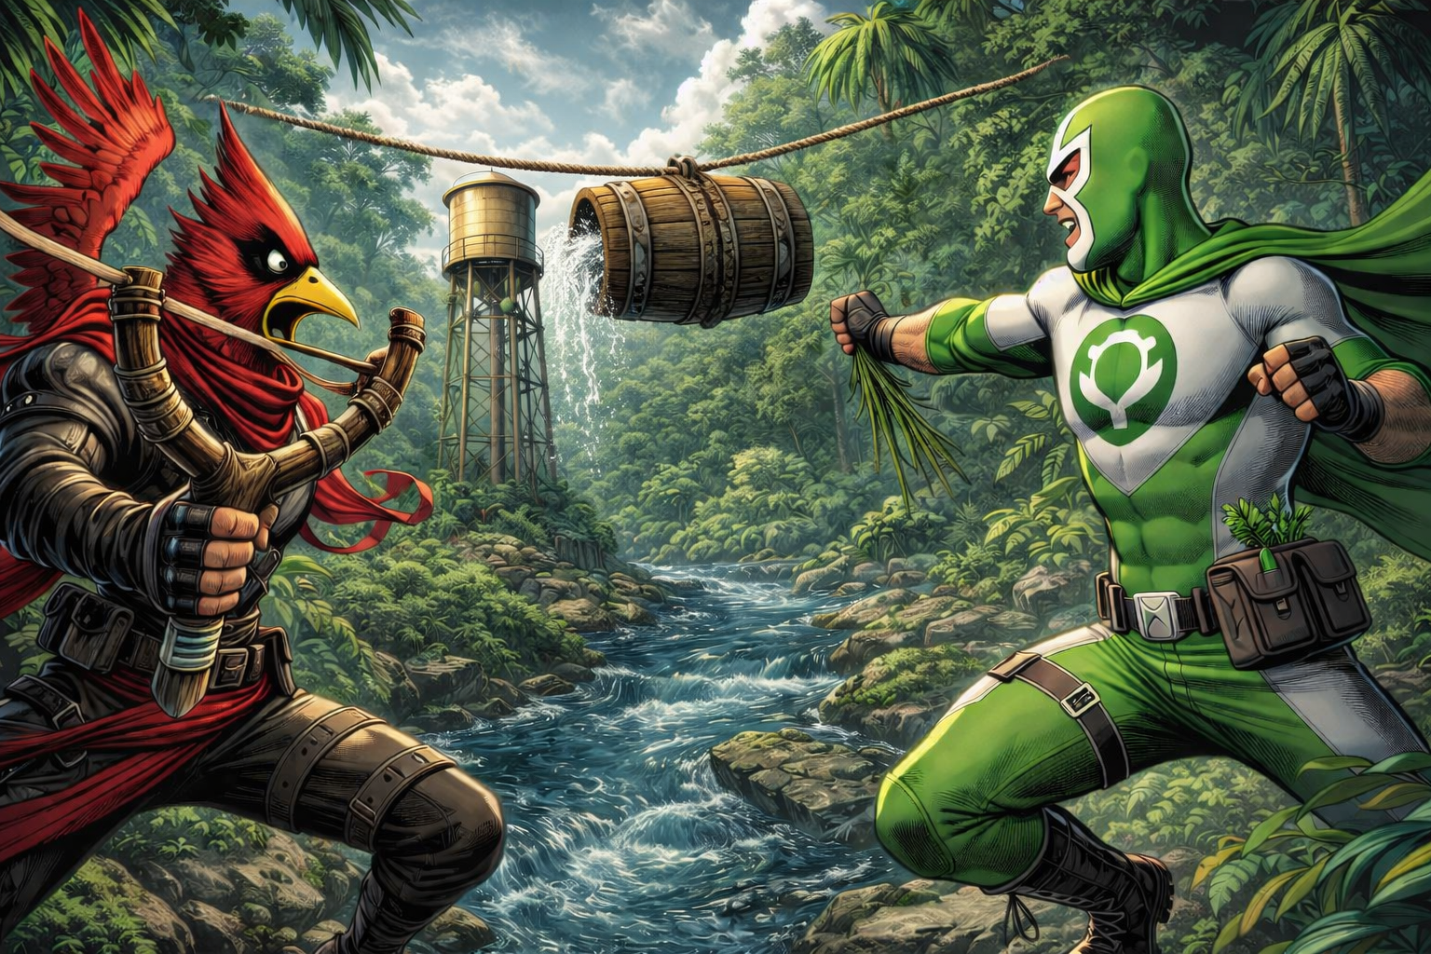
Squirt!
Team: 4 vs. 4
Objective:
Push the barrel across the rope to the opponent's side of the river. Do this by destroying the opponent’s fire hydrants, water towers, and firefighters, while keeping yours alive

Slide 6
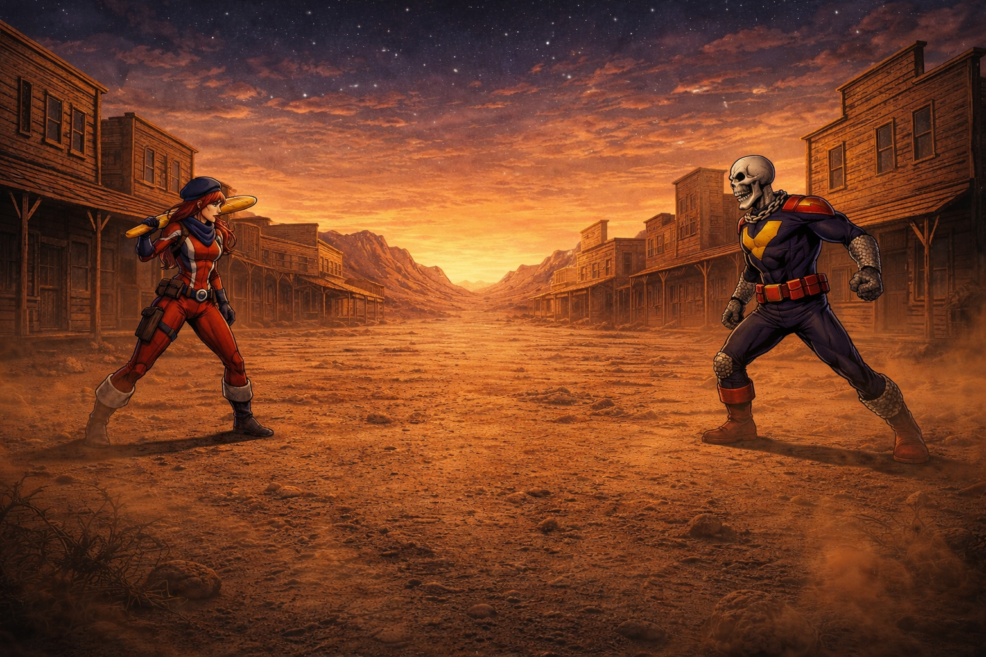
Duo Hoedown
Team: 1 vs. 1
Objective:
Kill your opponent to gain some of their money bags. First person to steal 4 money bags wins.

Slide 7
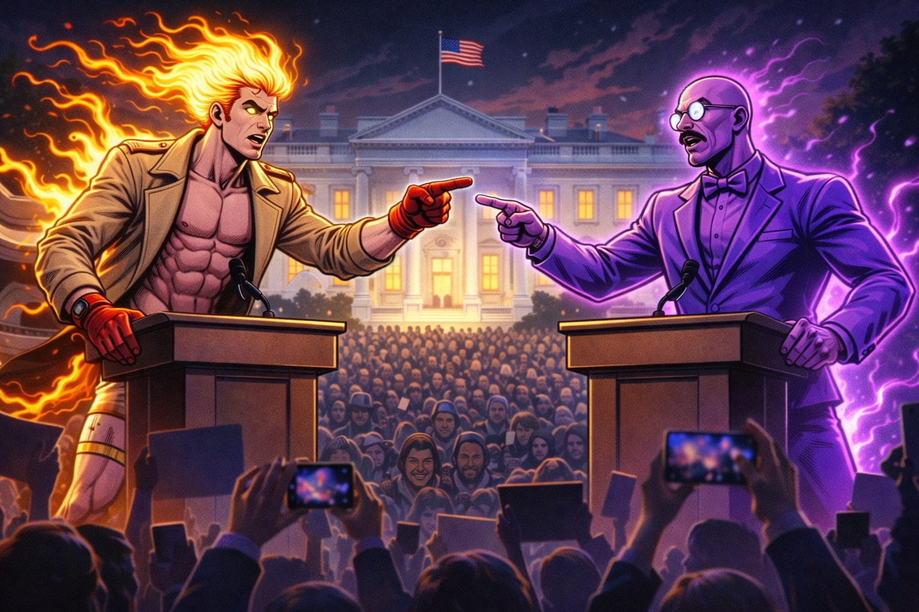
Campaign
Team: 5 player free for all
Objective:
Beat your opponents in an 8 month long Venezuelan Presidential Campaign.

Slide 8
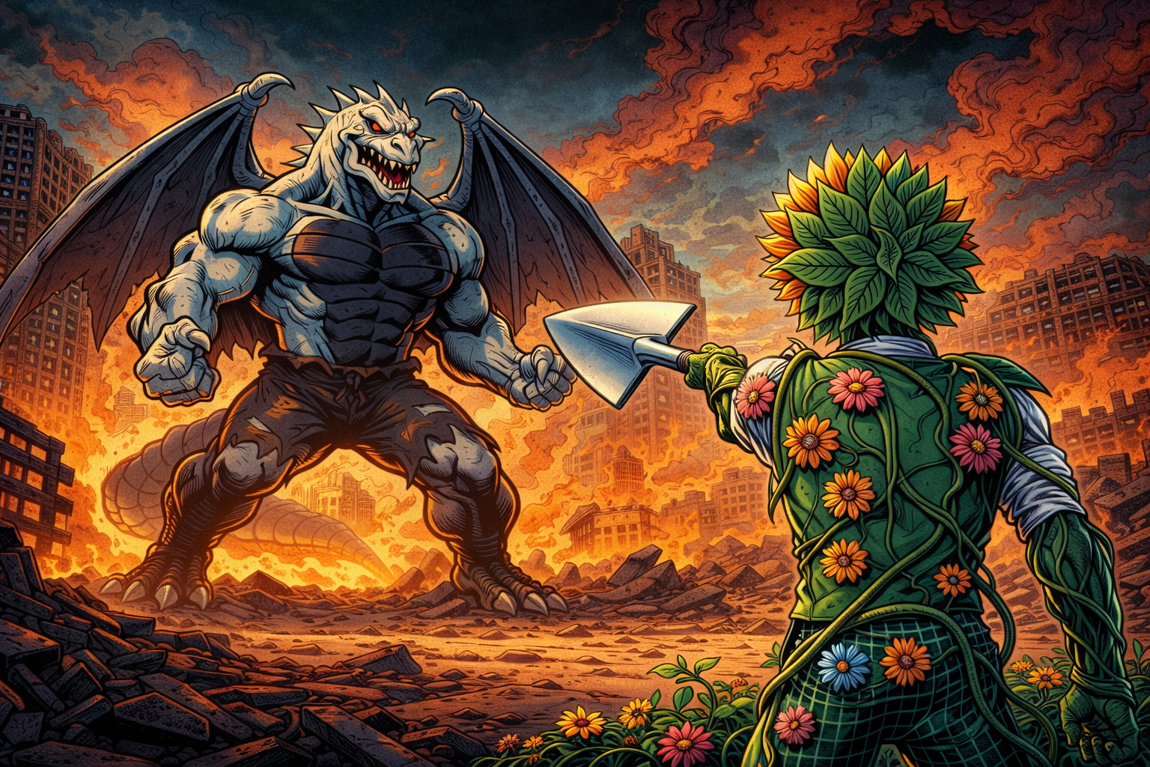
Story mode
Team: 1-4 player co op
Objective:
Destroy the undestroyables and defeat the darkest timeline to gain rewards and glory.

